Slide 1
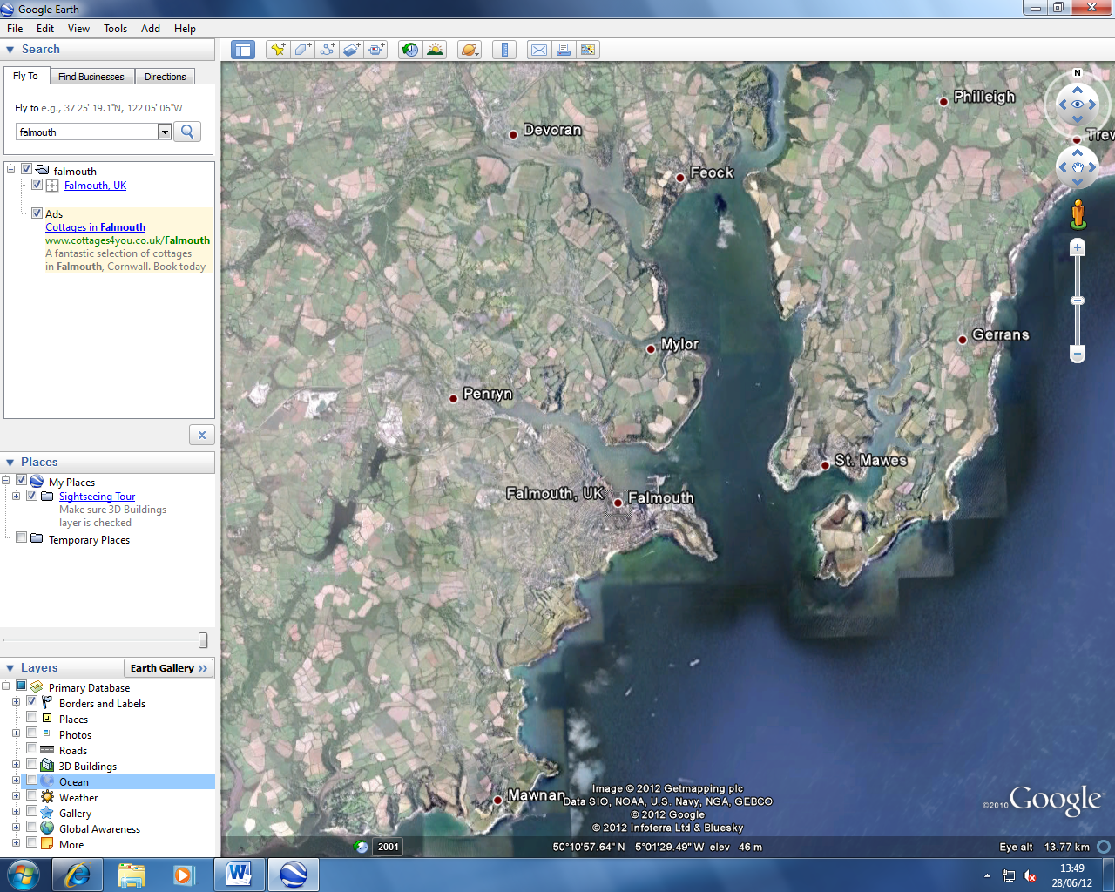
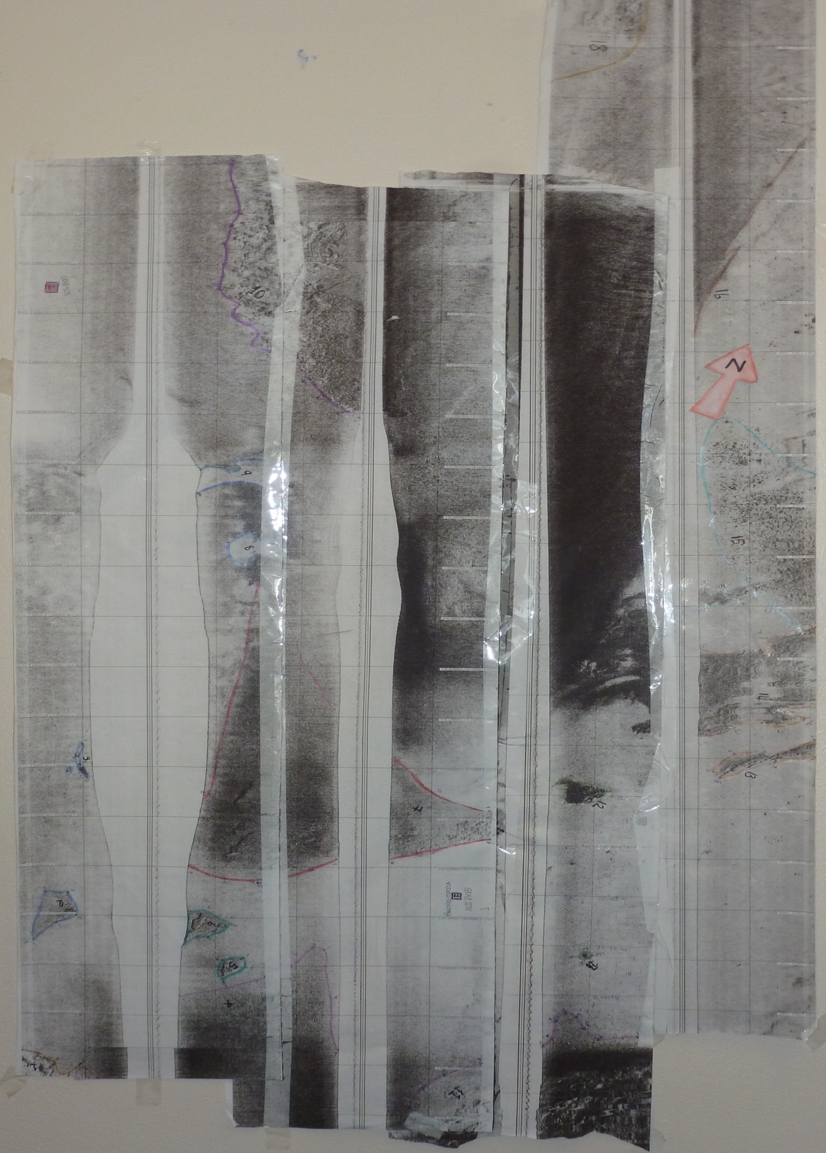
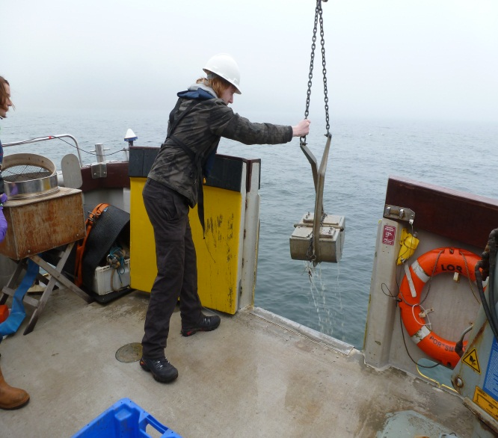
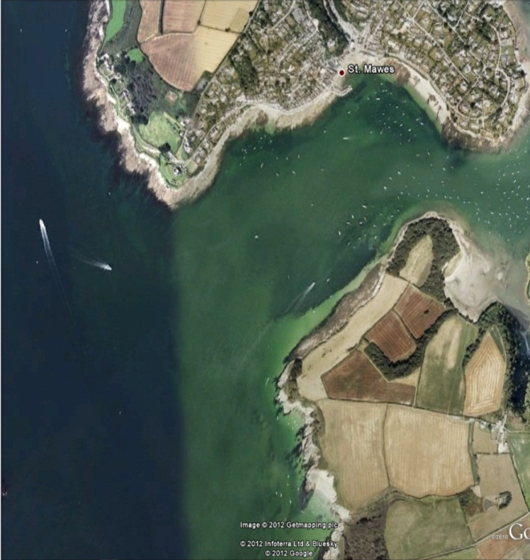
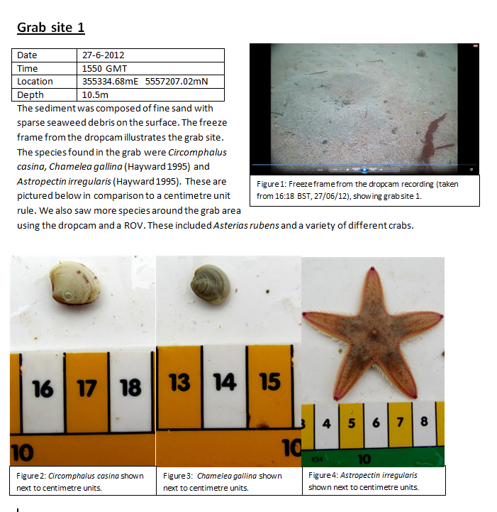
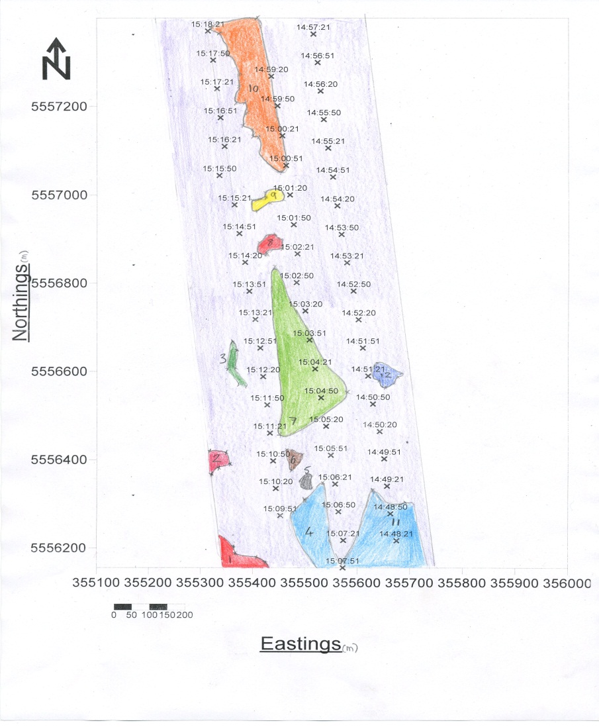
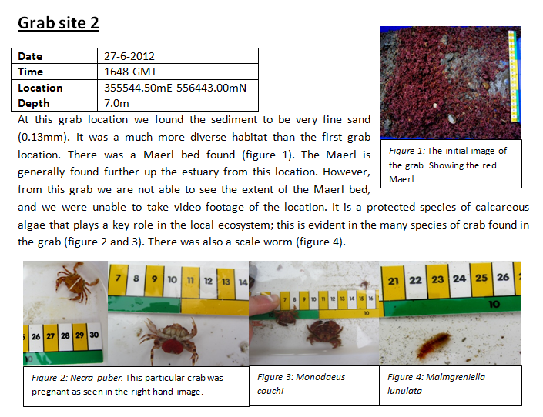
Mapping Benthic Habitats in the Fal Estuary A Geophysical Investigation by Group 9
Georgina Blow
Will Fuller
Zoe Gilbert-Hall
Emily Jones
Ioannis Komis
Jade Martin
Leighton Newman
Sian Ponting
Alexander Walton
Introduction and Methodology
Our survey set out to perform a habitat mapping survey of a small area of the Fal Estuary, UK, using a Sidescan Sonar and ground truthing techniques.
In order to perform habitat mapping we must create an image of the seafloor to as fine a resolution as possible. A subsurface Dual frequency Analogue Side Scan Sonar to fish operating at 100kHz at a depth of 3.5m. Swath width was 150m in total, 75m either side of the fish. 5 transects were plotted for our vessel to follow, though transect one was blocked by a moored boat. Once a Side Scan Sonar image was created, we calculated coordinates using the image at which ground truthing could be effectively performed. It was important to identify areas of sediment and not of a solid rock substrate in order to avoid damaging the equipment. We took two van Veen grabs at two different sites, and video recordings at the first grab site. The video recordings were taken on both a drop-cam and an ROV (remotely operated vehicle) with an HD camera attached, which each offer different perspectives of the sea floor. Each van Veen grab was 0.5m³. The contents of each grab were emptied into a container where the fauna was visually identified before returning to the same area of each grab.
Background Information
The Fal estuary was sampled because it contains two habitats which are of special scientific interest; Phymatolithon calcareum (maerl) beds and “meadows” of eelgrass (Zostera marina). The presence of these habitats has caused the Fal estuary to be designated a Special Area of Conservation (SAC). The research carried out is important in order to estimate the deleterious effect of proposed dredging in the estuary on the extent of the maerl and seagrass. The proposal is to dredge a deeper channel leading toward Falmouth port in order to allow large cruise liners to dock there. It is thought that the dumping of the dredged sediment may cover the maerl and eelgrass. A layer of sediment covering the maerl would block the light which it requires to photosynthesise and cause extensive mortality of maerl in the estuary. Research into the areas in which maerl is present can be used to ensure that disposal of dredged material is carried out accurately and far from this vulnerable habitat.
Both the maerl beds and the eelgrass “meadows” are important habitats as they provide shelter for benthic organisms such as crabs and scallops and nurseries for fish. This is beneficial to the ecosystem as it greatly increases the biodiversity of the estuary as well as providing economic benefit to the fisheries in the area. Maerl itself is calcareous red algae which forms beds of unattached individuals in certain benthic environments. The space between the individuals caused by their branching structure provides a habitat for small organisms which would otherwise be vulnerable on the sandy benthic habitat.
Date | 27/06/2012
Location | Fal Estuary, Cornwall, UK
Vessel | MV Xplorer
Time leaving | 13:29 GMT
Time returning | 17:30 GMT
High tide | 11:20 GMT 4.4m
Wind | F3
Total cloud cover | 8 Okats
Air temperature | 18⁰C
Sea surface | Calm to moderate
The Side Scan sonar mosaic with
highlighted gradients and artefacts.
Figure 2 - Map of Investigation site.
Coordinates: 50°09’20.00N,.
05°01’14.85W. (GoogleEarth 2012)
Figure 1 - A van Veen grab in use on SV Xplorer
SideScan Mosaic Analysis
We identified 18 zones in the area surveyed by the SideScan sonar. Overall the background showed a clean trace suggesting soft sandy sediment. In the northern area of the trace there appears to be a much darker area which is continuous along the whole of transect 3 suggesting that this could be due to alteration in contrast of the SideScan programme. Two grabs were taken, however these didn’t fall into any of the distinctive zones identified. . Grab 1 was taken in the south of the area surveyed and appears to be in an area of soft sediment, this was supported by the grab sample which consisted of a mixture of fine sand and mud. A dropdown camera was also used at this site which further supported these findings. Grab site 2 was in the west of the area surveyed and displayed similar patterns to that of site 1, however on observation of the grab sample it was discovered to be a maerl bed. Zone 13, 14 and 15 showed a transition of soft sediment into possibly harder rock indicating the decreasing distances towards the shore. One of the largest zones identified was zone 7 in the middle of the trace. This zone appeared to be darker indicating a harder, more reflective substrate. There were many darker areas indicating a change of bedform such as zones 5,6 and 12, this is unusual but it is not possible to identify without supporting evidence. In order to fully identify each zone grab samples and video imaging should be taken in each area. There were a few areas of uncertainty on the trace, highlighted in yellow. One area appears to be a wreck although further investigation would be needed to identify this. The other highlighted area shows what could be large shadows formed by boulders, but due to the contrasting of the trace this cannot be confirmed.
As a group, we faced several problems regarding the software involved in the analysis of our results. We collected a total of four transects, but our eastings/northings diagram only shows three. This was a result of the programme not capturing our 1st transect. Additionally, our course was not being recorded as the software had a malfunction during the investigation. Whilst this proved a great problem with respect to plotting our results, we were able to calculate and plot an eastings/northings graph using our raw data; an extremely tedious process!
Trace Map
This trace map was created using the northings and eastings collected on the side scan traces. The time was also allocated on each plot point and this produced a very clear plan of where the transects were taken and at what time. Although we took 4 transects, when we re-printed the traces containing the co-ordinates, the first transect (line 002) was not saved onto the system and so we were only able to create a trace map of lines 003, 004 and 005. The main artefacts identified on the side scan mosaic were then mapped onto this trace map (excluding any found on line 002 as we do not have this data). Descriptions of each of the artefacts identified can be found in the section providing detailed explanation of our side scan mosaic.
References
P.J Hayward & J.S Ryland, 2008, Handbook of
the Marine Fauna of North-West Europe, Oxford
University Press, New York.

