Slide 1
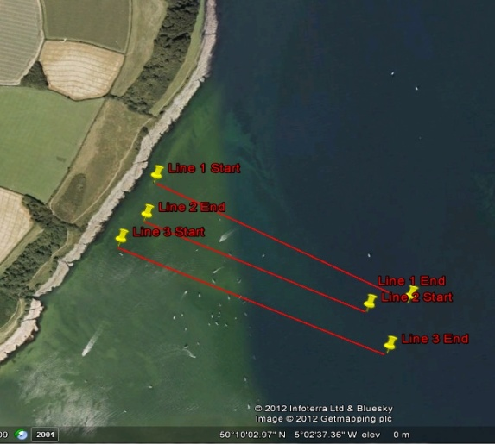
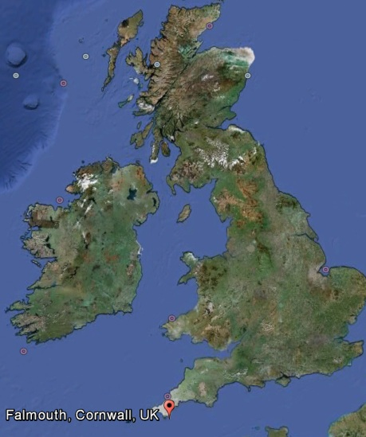
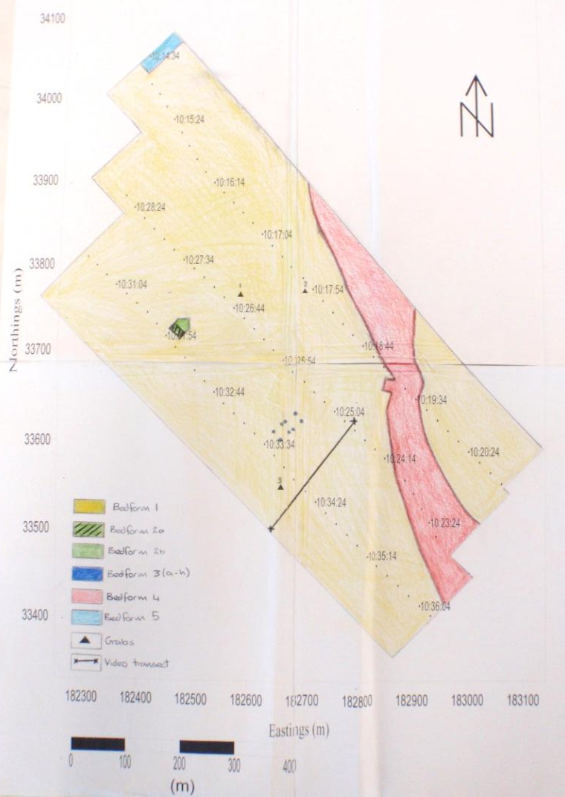
GEOPHYSICAL HABITAT MAPPING– FALMOUTH 2012 Group 4
Introduction
The Fal estuary, located on the south coast of Cornwall extends 18km inland making it reputedly the worlds third largest natural harbour, is a Special Area of Conservation (SAC) which is selected under the piece of legislation “The Habitats Directive”. The directive’s main aim is to highlight the need to maintain biodiversity throughout all member states of the European Community, with special emphasis on rare or threatened habitats or species.
Proposed dredging plans to make the port of Falmouth accessible by cruise ships is therefore a major concern for flora and fauna currently present in the channel. Maerl, a collective term for several rare species of calcified red seaweed, typically Lithothamnion corallioides and Phymatolithon calcareum grows as unattached nodules on the seabed, and is only present in the live beds of St Mawes, the only location of maerl in Cornwall. The dead calcareous skeleton which accumulates over time acts as a cenosis for other organisms, providing ideal conditions for them to thrive in these waters, proving particularly significant as nursing grounds for juvenile fish, ensuring a secure future for Cornwall’s fishing industry (Wildlife Trust).
With acknowledgement of the economic benefit that the dredging plan would impose on Falmouth and surrounding area, it must be noted that as a consequence there will be great disturbance to the seabed and local flora and fauna.
Our aim was to investigate the species, bedforms and sediments present using sidescan sonar, video camera and seabed Van Veen grabs and relate this evidence to the effect dredging would have on this SAC for Natural England.
Planning and methods
Geophysical track selection
The RV Explorer navigated to an area in the estuary where a proposed dredging site was situated, where sampling transects were planned in order to identify the type of habitat present. The tow fish (Geoacoustics 159D Dual Frequency) was towed behind the vessel during each transect at an average depth of 8m, utilising the property of the reflected acoustic pulse to essentially map the sea floor. Once stationed on the site, there was a planned start and end point of where the tracklines were going to be taken. Ensuring that the vessel remained perpendicular to the shoreline during the transects enabled the captain to maintain a reference point throughout completing the tracklines.
Three parallel transects were completed with a swath range of 200m per transect, observing the seabed to the west of Carric Roads. Spacing of 100m was used to ensure that there was some overlap on the sidescan sonar output, allowing the mosaic to be pieced together properly.
Sidescan Output
(Surfer) The plots were now ready to be printed and the bedforms observed on the sidescan can then be plotted onto the track plots.
Processing the sidescan output from the towfish involved transforming the linearly recorded trackplot into a mosaic, thus representing the entire sampling area covered by the towfish. This was completed with the aid of time stamps and initial markings of each transect start and end site, so the trace could be cut and stuck together in the correct position.
Therefore, the generation of a sidescan mosaic allows the establishment of a relationship between the distance and patterning on the paper trace and trackplot.
Boundaries of bedforms, bathymetry and anthropogenic structures can be mapped onto the sidescan mosaic by observing the change in tone and patterning. Calculating the true horizontal distance of these boundaries and structures requires the use of equations which converts the slant range measured as centimetres on the sidescan mosaic to the theoretical measurements within the water column.
Equations
Relationship between distance on paper trace and trackplot = $\frac{Hf(m)}{Hf(cm)}$ = $\frac{r(m)}{r(cm)}$
Fish height (m) = H_{f­}(m) = $\frac{r(m)}{r\left(cm\right)} x Hf(cm)$
Slant range (m) = R_{s}(m) = $\frac{Hf(m)}{Hf(cm)}$ x R_{s}(cm)
True horizontal range (m) = R_{h}(m) = $\sqrt{Rs\left(m2\right)−Hf(m2)}$
Tow fish
Figure 4. Sidescan and surfer final output
Water column
Sidescan interpretation
Five different bedforms can be identified from the sidescan mosaic. Bedform 1 shows the general background bedform for the sampled area, which ground truthing from the drop camera revealed to consist of maerl sands and skeletal maerl fragments.
Bedform 2 is split into two bedforms; 2a and 2b. 2a is higher than 2b by around 30m, (values of R_{h} in bedform 2a average 93m in comparison to 63m of bedform 2b). The lighter tone of bedform 2b indicates a decrease in seabed depth as a result of decreased backscatter to the transducer on the tow fish, suggesting some scouring in this area has taken place.
The regularity of bedform 3 suggests this could be a manmade structure, such as a standing platform, although the confirmation of this requires further substantial evidence.
Bedform 4 shows the steeply graded drop off into the main channel of Carrick Roads, represented by lighter tonal shading on the sidescan.
Bedform 5 shows an area of lines with regular intervals, indicative of ripples in the sediment, represented by banding patterns of consecutive increased and decreased depth of the ripple. As most of this area is sand sediment there is a higher likelihood that these are sand ripples.
Plotting Navigation Data in Surfer
Navigation data of the three tracks were arranged into the date, time (AST), eastings, northings, depth and survey line number. Surfer was then used to plot this navigation data into 3 straight track plots, showing the positions at which the sidescan sonar was used.
The maps showing position and time were overlayed, i.e. placed on top of each other in order to generate one map showing multiple variables, including sites of grab sampling.
Mound
100m swath
Acoustic shadow
Sea floor
Figure 3. Schematic of towfish and sidescan sonar
Grab sampling
Grabs were planned to ground truth the sidescan output and to identify species present and were taken as close to the track lines as possible. The van veen grab was lowered to the sea bed by the on deck winch and was electrically signalled to closed at the sea surface, obtaining the top 10 inches of sediment.
Video sampling
A drop camera (UoS) towed behind the boat was used to video the sea bed to ground truth our side scan plot and also to identify species present within the area surveyed. We combined this with grabs of the sediment, which could be used to analyse the sediment particles’ size and composition.
Grab sample analysis
When analysing the grab samples, it can be seen that the sediment consists of a bioclastic sand mixture of Maerl gravel with mixed sublittoral muddy sediments. There was a consistently higher percentage of skeletal maerl fragments compared to live specimens in each of the grabs, with the largest pieces of maerl measuring at approximately 2cm.
Maerl provides an attachment site for fauna and flora, such as Chondrus crispus, Furcelleria lumbricalis and other unidentified rhodophyta, which was most abundant in grab 3 and visible frequently in the video footage.
The most commonly found infauna were bivalves, found in abundance in all three grabs. Astarte sulcata was easily identifiable due to its broadly oval shape, bearing approximately 20 pronounced concentric ridges.
(A study from 2003, stated in the Environmental Assessment, Marine Ecology section of the Port of Falmouth Development Initiative, that the maerl bank community was characterized by abundant vagile epifanua, notably gastropoda, utilizing the shelter the lattice of maerl provides, of which the most abundant species was Bittium reticulatum which we found in Grab 1. (falport)).
Grab 1 –Spirorbis spirorbis (polychaete), unidentifiable polychaete worm and red nematode worm (due to unclear photo observations).
Grab 2 - Ammodytes spp. (sand eel) (fig 6), Liocarcinus holsatus (3x crustacean) (fig 5), Echinocardium chordatum, (echinoderm)(fig 5).
Grab 3 - Ascidia conchilega (tunicate) Liocarcinus spp. (2x), unidentifiable crab (of the infraorder Brachyura).
Figure 5. Photograph from grab 2
References
Port of Falmouth development initiative: Project Programme – Dredge Disposal and Maerl Mitigation, [online] (2009), Available at: http://www.falmouthport.co.uk/commercial/html/documents/ProjectProgramme-DredgeDisposalandMaerlHabitatMitiga.pdf, [accessed on : 02/07/2012]. Fal Docks dredge, Habitats Directive review and the ‘reference area’ for maerl, [online], no date, Available: http://www.cornwallwildlifetrust.org.uk/OneStopCMS/Core/TemplateHandler.aspx?NRMODE=Published&NRNODEGUID=%7b74D3FA9B-C8C9-4EBA-9FDF- 153F4393E9A6%7d&NRORIGINALURL=%2fconservation%2fposition
statements%2ffal_docks_dedge_and_the_reference_area_for_maerl&NRCACHEHINT=NoModifyGuest [accessed on: 02/07/2012].
Figure 6. Ref.

Slide 2
Line 1 was taken from 09:14:44 UTC to 09:20:48 UTC, with a start point of longitude 5º 02’53.7491 N, latitude 50º 09’57.2334 W. The end point was longitude 5º 02’20.8860 N, latitude 50º 09’43.355 W.
Line 2 was taken from 09:23:14 UTC to 09:28:40 UTC, with a start point of longitude 5º 02’26.6322 N, latitude 50º 09’42.4232 W and an end point of longitude 5º 02’55.6142 N and latitude 50º 09’53.43 W.
Line 3 was taken from 09:30:32 UTC to 09:36:16 UTC, with a start point of longitude 5º 02’59.456 N and latitude 50º 09’51.22 W, with an end point of longitude 5º 02’24.4466 N and latitude 50º 09’38.55 W.
Grab 1 was taken at 10:00:08 UTC at longitude 5º 02’44.4576 N and latitude 50º 09’49.4616 W, with the seabed at 10m depth.
Grab 2 was taken at 10:44:15 UTC at longitude 5º 02’38.3304 N and latitude 50º 09’56.5728 W, with the seabed at 9.3m.
Grab 3 was taken at 11:16:33 UTC at longitude 5º 02’40.0812 N and latitude 50º 09’43.0806 W, with the seabed at 10m.
The drop camera started recording at 10:50:04.136 UTC,182568.16,33684.22,0.00,0.00,0.00,263.2,58.96, and the Camera ended recording at 11:03:04.136 UTC,182596.01,33787.89,0.00,0.00,0.00,227.9,-42.41.

Slide 3
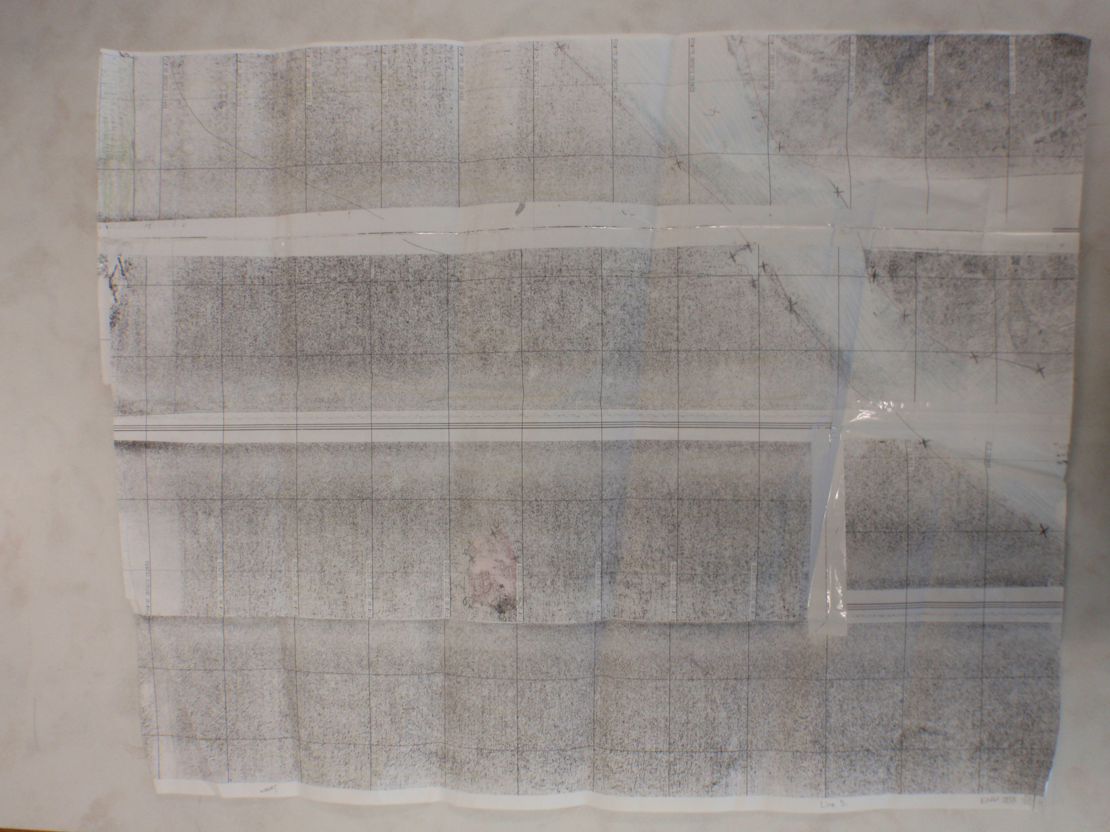

Slide 4
