Slide 1
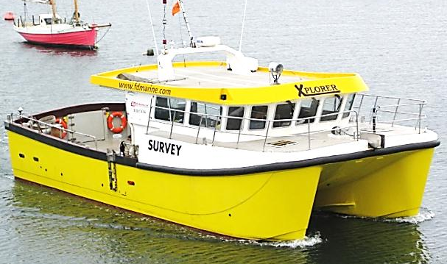
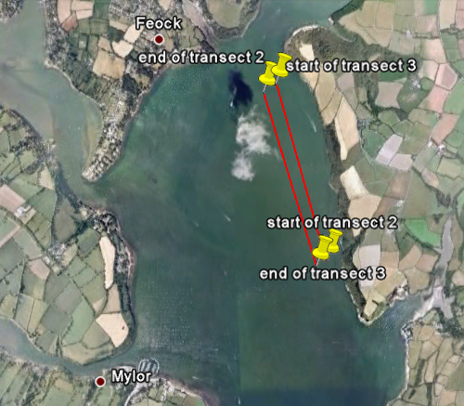
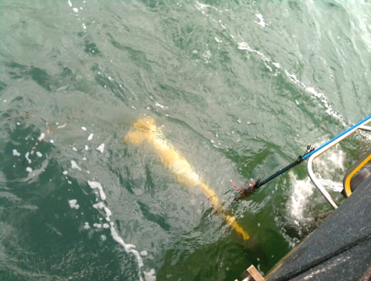
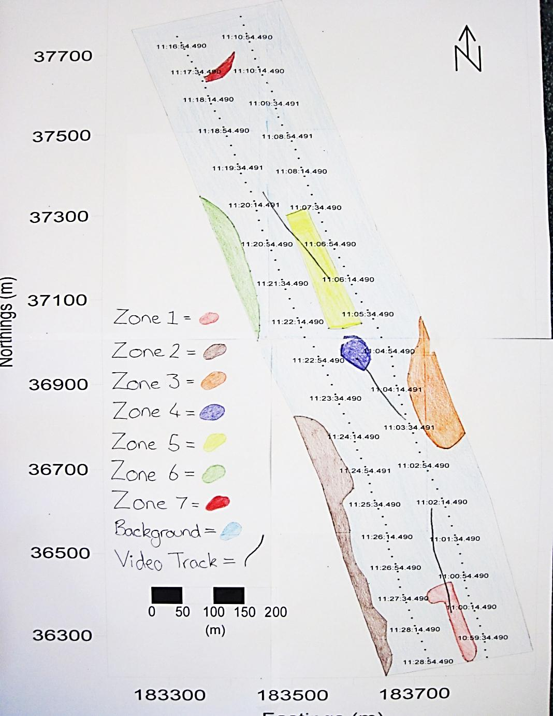
Geophysical Habitat Mapping
Falmouth 2012 Group 2:
Hazel Aslin, Carlo Bella, Marina Brassington, Clair Caldwell, Michael Hughes, Sarah Lane, Federico Pastorelli, Julie Seager-Smith, Georgina Selwyn, Ben Smith
1. Introduction
Aims
Date: 29/06/2012
Vessel: Xplorer
Departure: 07:25 GMT
High water: 12:38 GMT, 4.40m
Low water: 06:38 GMT, 1.30m
Instruments: sidescan Sonar, DropCam
Crew: 2 + 12 passengers
Habitat map a confined area in the Fal estuary using acoustic sidescan sonar
transects
Provide video data to ground truth sidescan results
Observe/record any gradations in habitat type along each survey transect
Equipment
Location and Site Background
Sidescan sonar
Used to search for, and detect objects on the seafloor
Requires 3 main components:
Towfish – transmits and receives acoustic pulses,
Transmission cable - connected to towfish and sends data to the ship
Processing computer – plots data points for visual analysis (NOAA, 2012)
By consulting weather and tide data a suitable area was decided to be in the north-east of the estuary near the coast
Fal Estuary
Located on the English south coast
Many designated SAC sites due to:
(Cornwall Council, 2012)
Large shallow inlets and bays
Saltmarshes
Intertidal mudflats
Subtidal sandbanks
Important to habitat map for continuing
conservation of the SAC
DropCam
Deployed through water column to
benthos
Sites perpendicular to sidescan transects
Several minutes footage obtained for
ground truthing
Results
Sidescan
Transect 1 not used for results due to poor data quality.
Zone 1: DropCam evidence, coarser sediment, perhaps more shells
Zone 2: Spottier picture, higher proportion of shells
Zone 3: Diagonal (SW) pattern, from flow pattern
Zone 4: Shadow areas – isolated raised seabed section
Zone 5: Coarser sediment (shell or gravel) in higher abundance to south,
fading out to North. DropCam shows macroalgal evidence, varied
on sidescan picture
Zone 6: Same as Zone 2
Zone 7: Finer sediment, soft mud surrounded by shell and macroalgae
Background —> mostly fine sediment e.g. mud.
DropCam
Table 2: Macroalgal species and benthic species found at each drop site
Method
5 transects planned on west of estuary with SE – NW heading –
abandoned after transect 1 due to conditions and new location decided
5 transects planned on east of estuary – 2 completed due to time
constraints
Towfish deployed at new location (see table 1)
Towfish depth = 1 – 2m, transect length 1.6km
Data sent to on-board computers for analysis
Locations for DropCam sites decided and footage recorded on on-board
computers
Latitude, Longitude, Eastings, Northings and time recorded manually and
electronically
Table 1: Start and end latitude, longitude and time for transect 1 (abandoned), 2 and 3.
Transect | Start Time/ Latitude | Start Longitude | End Time/ Latitude | End Longitude
1 | 50°11’07.4502N 08:49.09 AST | 005°02’11.8865W | 50°11’34.1106N 08:59.09 | 005°02’55.4808W
2 | 50°11’12.5052N 09:59.11 AST | 005°01’47.4222W | 50°12’03.3146N 10:11.11 AST | 005°02’10.3734W
3 | 50°12’00.7278N 10:15.45 AST | 005°02’15.7998W | 50°11’11.0628N 10:28.45 AST | 005°01’51.7444W
First drop site |  | Second drop site |  | Third drop site
Macroalgae | Benthic species | Macroalgae | Benthic species | Macroalgae | Benthic species
Rhodophyta Chlorophyta | Molluscs (scallops, invasive slipper limpets) | Rhodophyta Chlorophyta | Few due to nearly 100% algal benthic coverage | 2 Rhodophyta species 2 Chlorophyta species | Similar to other sites: Sabella (site with higest abundance), scallops, sand mason worms, fish (possible juvenile pelagic species)
High density; Chlorophyta dominance over Rhodophyta | Annelids (Sabella worm) | Greater density than site 1; Chlorophyta dominance over Rhodophyta | Low diversity, high dominance | Low dominance; equal Chlorophyta and Rhodophyta distribution - | Exclusive to site 3: decapods, hermit crab, benthic crab, gastropod shell
 | Fish species similar to Mottled Sculpin
 |  |  | Some sediment patches with mollusc shell covering
 | Sand mason worms
Conclusions
DropCam footage gave insight into species composition and variation, it revealed:
Notable macrofauna and macroalgae changes between the 3 sites
Similar species composition at the 3 sites
Largest biodiversity found at site 3 – may be significant as it was the only site where the invasive slipper limpet was absent which could result in more ecological niches being present due to high recruitment
DropCam footage also corroborated the benthic habitat predicted by the sidescan traces
Sediment was generally coarser to the south and fined towards the north – due to strong tidal currents carrying fine sediment further north into the estuary, but depositing the coarse sediment in the south at the mouth of the estuary
Overall data shows that the benthic habitat in that area of the estuary is relatively homogeneous, with gradations of the density of macrofauna and macroalgae
8. Limitations
9. Future Work
Weather – strong winds from south created large swell – caused towfish to come out of water on transect 1 – had to change survey location and discard transect 1
Relatively homogeneous seafloor – few noticeable features
No grabs possible as didn’t have correct licensing
Time constraints prevented using ROV camera
Obtain licensing so can do grabs for further ground truthing
Use HD camera on the ROV for better video footage
More transects in same area
Extend survey area over more of the estuary and river
Survey at different times of year to see seasonal and annual variations
10. References
Cornwall Guide. 2012. The River Fal. [Online]. Available at <http://www.cornwalls.co.uk/Falmouth/fal_river.htm> [Accessed 30.06.2012].
NOAA Ocean Explorer. N.d. Sonar. [Online]. Available at <http://oceanexplorer.noaa.gov/technology/tools/sonar/sonar.html> [Accessed 30.06.2012]

